Slide 1
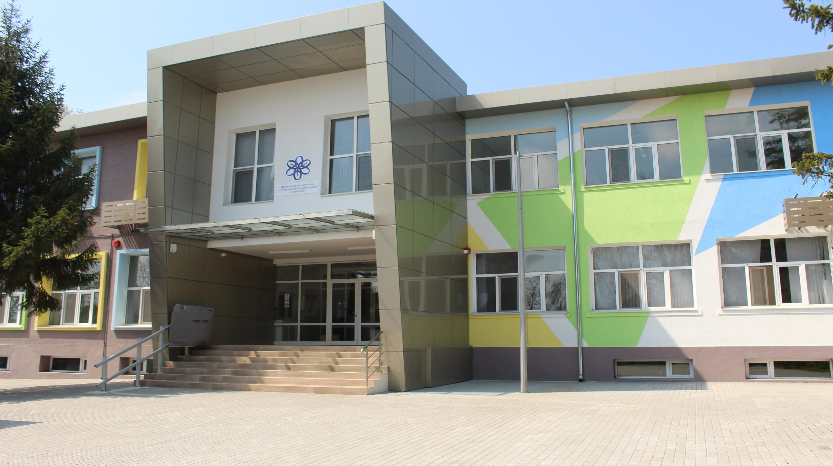



ROBOTICS 2023

Slide 2
The history of robots
By Tech_Monkeys

Slide 3

Mission
Our mission is to educate people about the history of robots and robotics in an easy and interesting way.

Slide 4
Roles
Scrum Trainer- Petko Kovachev (8g)
2. Designer - Ivaylo Gyurov (8b)
3. Front-end developers - Veselin Boyanov (8a), Aleksander Lalev (8v)

Slide 5





Apps and features used during the development of the project

Slide 6




Apps and features used during the development of the project

Slide 7
Thank you for the attention!

